Slide 1
ADHD AND EXECUTIVE FUNCTION DEFICITS
What are Executive Functions?
What causes Executive Function Deficits?
What can parents of students with EFD do to help them function at their best at school and at home?
West Windsor PTO October 2018

Slide 2
Who am I?
Jane Milrod-
Founding Director of CHADD Princeton-Mercer County (established 2006)
CHADD-Certified Parent to Parent Teacher with 13 years of experience
Attained the highest level of training (ACCG and Professional Advanced Coach) from The ADD Coaching Academy
ADHD Academic Coach for High School and College and Graduate Students, and an ADHD Career and Life Coach for Teens and Adults.

Slide 3
What are our data sources?
CHADD Parent to Parent Course in ADHD Education
Chris Zeigler-Dendy’s Presentation on Executive Function Deficits at CHADD’s 20th annual conference
Peg Dawson and Richard Guare’s “Executive Skills in Children and Adolescents, A practical guide to assessment and intervention.”
Sandra Reif’s “The ADHD Book of Lists, A practical guide for helping Children and Teens with Attention Deficit Disorders”
“Attention” Magazine: “Understanding the link between Executive Functions and school success”, February 2008 author: Chris Zeigler Dendy.
Dr. Ari Tuckman, “More Attention Less Deficit, Success Strategies for Adults with AD/HD.” Website adultadhdbook.com
Dr. Thomas Brown, “A New Understanding of ADHD in Children and Adults” (2013)
Dr. Russell Barkley, “Executive Functions: What They Are, How They Work”
Eric Tivers ADHD ReWired Podcast and Website
Susan Lasky – Organizing for ADHD- ADDITUDE Magazine Webinar
“The Organized Student” by Donna Goldberg
Judith Kolberg and Kathleen Nadeau “ADD Friendly Ways to Organize Your Life”

Slide 4
WHAT ARE EXECUTIVE FUNCTIONS?
Executive functions are brain-based skills required for humans to effectively perform tasks and solve problems.
They impact our ability to organize, prioritize, and analyze, in order to make reasonable decisions and plans and complete tasks.

Slide 5
Executive Functions are
“the brain’s conductor”
- Dr. Tom Brown
The conductor organizes, activates, focuses, integrates, and directs the musicians as they play, enabling the orchestra to produce complex music.
Similarly, the brain’s executive functions organize, activate, focus, integrate and direct, allowing the brain to perform both routine and creative work.
Executive Functions manage the brain’s self-regulation.
Notes:
Notes:
Thomas Brown, Ph.D., compared impairment of executive functioning to having a symphony orchestra of concert-quality musicians without a conductor.
Picture walking into the concert hall as the symphony players are sitting at their places on the stage warming up their instruments and practicing various passages, everyone playing something that might be from a different piece of music and in a different key.
In a few minutes the concert master stands up and directs the musician to tune their instruments to the “A’ that the oboe player is now sounding for them.
When everyone is “in tune” the concert master sits down and the orchestra conductor walks on to the stage, mounts the podium and picks up the baton and raises his arms.
As he gives the upbeat signal to the symphony players, he begins to organize, activate, integrate and direct the musicians as they play, enabling the orchestra to produce beautiful, complex musical sounds.
Without the conductor to make sure everyone is playing together at the right tempo and following on the same page and in the same key, the music simply cannot sound as the composer intended it to.
Brown outlines tasks that require executive functioning:
Tasks that involve managing oneself without somebody else micromanaging
Tasks that require individuals to prioritize, start and stop, sustain and shift, and integrate other things
Tasks where memory is required

Slide 6
WHAT IS SELF-REGULATION?
Any action a person directs toward one’s self (a behavior-to-the-self)…
^{To} change their own subsequent behavior from what they otherwise would have done…
In order to change the likelihood of a future consequence.
Dr. Russell Barkley

Slide 7
WHAT IS THE ADHD/EXECUTIVE FUNCTION CONNECTION?

Slide 8
“THE PREFRONTAL CORTICAL NETWORKS INVOLVED IN EXECUTIVE FUNCTIONS ARE THE SAME NETWORKS IMPLICATED IN SELF-REGULATION AND ADHD.”
Dr. Russell F. Barkley

Slide 9
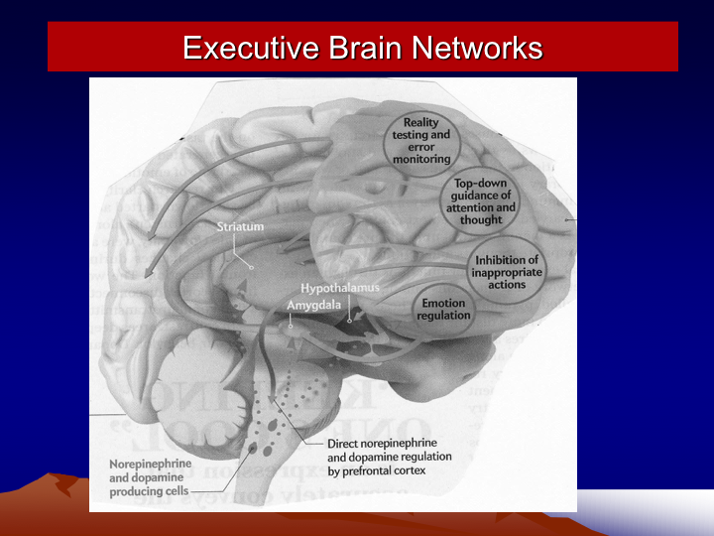

Slide 10
What causes EF deficits?
Recent NIMH neuralimaging studies of ADHD brains show clear evidence of:
Differences in the ADHD brain size and structure, particularly in the pre-frontal cortex, the basal ganglia, and the cerebellum.
Delayed maturation of these brain regions by 3 years on average (and up to 5 years).
A lower than normal blood flow in these regions.
Differences in the thickness of cortical tissue, and in the white matter tracts that connect and provide critically important communication between various regions of the brain.
Abnormalities in 2 dopamine receptors and a dopamine transporter gene that prevent efficient and complete message delivery. This results in, for example, lapses in memory and attention, missed information, and poor emotional regulation.
Networks of neurons that manage the brain’s management system require adequate neurotransmitters for clear message transmission; the ADHD brain tends not to release enough of these chemicals, or to release and reload them too quickly.
A slower conversion of simple sugar (glucose) into brain energy, which produces a slower rate of reactivity and cognitive processing in an ADHD brain.

Slide 11
Biological Underpinnings
Because dopamine enhances the level of interest a person attaches to a stimulus, people who release dopamine at a lower rate might find it more difficult to work up the enthusiasm to act on a stimuli they don’t find naturally appealing.
IMPLICATIONS: students with ADHD find it much more difficult to apply themselves to tasks that are not intrinsically interesting to them. Source: Peg Dawson

Slide 12
We also know that Executive Functions can be Adversely Impacted by….
Anxiety
Sleep deprivation
Dehydration
Inactivity
Depression
Stress
Menopause
Co-existing Conditions

Slide 13
Individuals with ADHD tend to have impaired Executive Functioning in these
6 EF Clusters:
Activation: organizing tasks and materials, estimating time, getting started.
Focus: focusing, sustaining focus, and shifting focus between tasks.
Effort: regulating alertness, sustaining effort and processing speed.
Emotion: managing frustration and modulating emotions (especially anger/ RDS)
Memory: using working memory and accessing recall.
Action: monitoring/ regulating actions.

Slide 14
Therefore, a person with ADHD has difficulty:
Getting and staying organized
Starting tasks (especially boring ones)
Keeping attention focused
Remembering what was just read or heard
Sustaining effort to complete tasks
Controlling impulsivity
Regulating emotions (especially anger)
Managing time
Using internal self-talk

Slide 15
Knowing is Easier than Doing
ADHD is a disorder of actualizing good intentions
People with ADHD usually know what the right thing to do is, but don’t do it consistently.
Executive Functions are the highest level cognitive processes; they help us create a better future.
This often means sacrifice in the present, which is very difficult for the NOW-oriented ADHD brain.
*Dr Ari Tuckman, PsyD

Slide 16
Students with EF deficits often look like they have made a conscious choice to not pay attention, to speak out of turn, to not listen, to break rules, to distract and annoy those around them, to interrupt, to act out…so
They are blamed for behaviors of which they may not even be aware, and which they cannot fix on their own.
Parents and teachers must adopt a Disability Mentality to keep from making incorrect judgments about ADHD behaviors.
Punishment does NOT cure ADHD!

Slide 17
How to Manage Executive Functions
The Basics
Sleep
Food
Exercise
Sunshine (Vitamin D) 30 minutes a day
Medication
Vitamin C – Connection – Buddies, Friends, Professionals

Slide 18
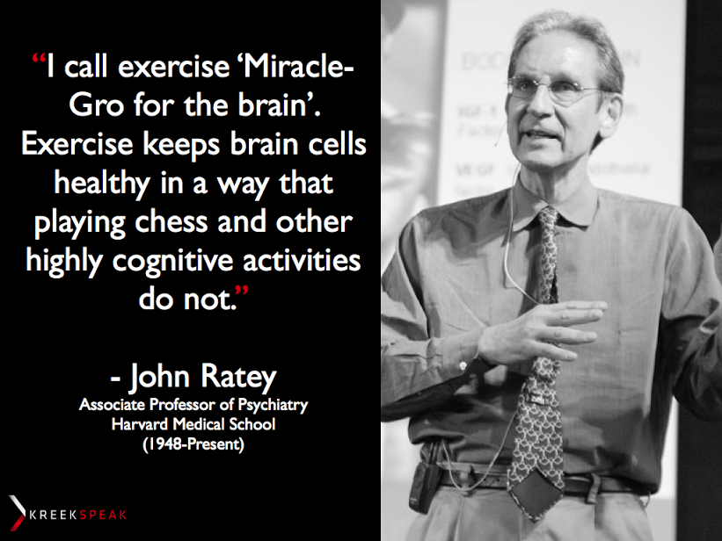

Slide 19
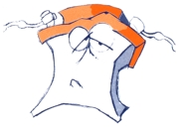
Effort and Persistence
Brains with EF Deficits have a shorter Battery Life
Plan for this, schedule frequent breaks
Pomodoro Technique
Brain Breaks and Energizers

Slide 20

Problem Solving
ADHD Detective – model the habit of noticing what works and what does not
Brainstorm together - try to figure out the solutions together

Slide 21
How can parents help?
Structure, structure, structure!
Make the household daily routines predictable. Figure out when your child’s high energy times are and work from their. Forewarn your child about upcoming breaks in the routine!
With your child’s help, create a daily schedule and put it in writing. Schedule times for important daily activities including home work and chore completion, mealtimes, practice time, free time, and bedtime.
Post this schedule in a visible location, and encourage the habit of checking-in with the schedule several times each day. This is an important lifelong habit for staying on task and on time.
To help with better control of ADHD’s instant gratification urge, reinforce (and manage, if necessary) “Work Before Play” – reinforce the concept that once work is completed, THEN he/she will be able to engage in a highly valued activity or obtain a highly valued reinforcement. ADHD brains need lots of external motivation!

Slide 22
Routines Rule !
Establish routines for a more organized, less stressful school year
Morning/leave for school
Afternoon/ homework
Dinner
After Dinner
Bedtimes
Weekend school prep/planning
When creating a ROUTINE, discuss acceptable options together
then let your child choose

Slide 23
Space Maintenance
Launchpad: assign a standard spot near the dorr to keep the backpack sports equipment after school items, (socks, toothbrush )
Landing Pad: Determine a time and place to empty the bag of the Homework/Notices folder, planner, Miscellaneous Papers folder and necessary items for that day’s homework
Post a Checklist as a reminder of what to take that might not already be in the bag (lunch/money, permission slips, water bottle, musical instrument)
Take a Photo of the bag and binder that shows how they look when ideally organized (memory fades quickly)
If you do not have a separe set of books for home set reminders to bring books home and return do the same for library books and put them on the calendar

Slide 24
Daily Maintenance
Determine a time (just before bedtime?) to
check that everything has been returned to the bag (including completed homework, texts, notebooks, et al),
put the bag on the launchpad where it will be seen and not forgotten in the morning, and include
other items that need to go to school for that day of the week (lunch, projects , sports equipment, music & instrument, library book, etc.)

Slide 25
Weekly Maintenance
Structure and Consistency Make a Difference
Set a time (Sunday night?) to go through the backpack and binders, especially the divider pockets, to weed out anything that doesn’t belong, and make sure everything that does belong is in the bag. Work from a list to refresh supplies.
Do the same with the desk and other work areas. Put papers that need to be saved for test review into a separate clearly labeled filing system at home.
Focus on Organizing, not Critiquing – ignore academics and the junk

Slide 26
Barkley’s “Prosthetic ADHD Aids:”
Use Technology!
Calendar: paper or electronic, use and monitor all day long
Wrist minders, time – timers, alarm clocks, pocket alarms, timer apps with alarms, clocks everywhere!
Visual aids: post it notes, pictures, signs (using fewest words possible), objects as reminders
Reminders to self: Texts, calendar reminders, voicemail reminders, people reminders!
Document and Time Management apps

Slide 27
Time Management Strategies
Embrace the use of a written planner for school and personal use
  Could be school choice, computer generated or electronic device
  Google Calendar and I phone Calendar also options.
Develop a schedule for completing a task
Write it down, make it visible, include reminders
Notes:
Notes:
Excellent resource: Teenagers with ADD, A Parent’s Guide – Chris A. Zeigler Dendy

Slide 28
Software and Apps That Will:
Regulate online usage
Increase Self Awareness
Block social media sites
Limit time web surfing
Track computer time
Block distractions
Alerts to passage of time
Improve concentration and focus
Monitor exercise diet, sleep
Track medication

Slide 29
Assistive Technology
SPEECH TO TEXT:
Software on computers tablets and phone
Dragon Naturally Speaking
NOTE-TAKING :
Live scribe pen and Audio recording devices and apps

Slide 30
Tips for working with teenagers
Pick your battles
Use natural or logical consequences
Make access to privileges contingent on performance
Be willing to negotiate (make deals!)
If something in non-negotiable, ask this question: What will it take for you to go along?
Involve others when you can (tutors, teachers, guidance counselors, coaches)
Source: Peg Dawson

Slide 31
Critical role of Emotions in EF
Need to be in the right frame of mind to bring your EF system on line
Pay attention, check in and take a pause
Emotional detective – Find what works for you
Meditation (bonus!) (class)
Parents: Ask questions, be curious not furious -

Slide 32
Keep Your Eye on the Biggest Prize:
Building Goal-Directed Persistence
Model this yourself- If your child sees you persisting over time to achieve a long term goal (a new exercise habit), that can make an impression.
Help him/her set and achieve little goals – they add up over time.
Praise effort –”Wow you stuck with it!” “ You figured it out”, “Can you believe how hard you worked for that, way to go!”
Emphasize your CHILD’S goals (not yours).
Source: Peg Dawson

Slide 33
GET HELP IF YOU NEED IT!
If your frustration level is causing major stress….If you’ve stopped being mom or dad or spouse and become a warden…
ADHD Coaches (who work with students your child’s age)
Homework Helpers/Study Buddies
Tutors
ADHD Parenting Classes and Parent Coaches
Professional Organizers
Never suffer alone – Support groups, CHADD Parent to Parent Class

